Slide 1
Building Artificial Neural Networks
Build Multi-Layer Perceptrons (MLP)
Build Convolutional Neural Networks (CNN)
Build Recurrent Neural Networks (RNN)

Slide 2

Build Multi-Layer Perceptrons (MLP)

Slide 3
Artificial Neural Network (ANN)
Artificial Neural Network: A machine approximation of a biological neural network for the purposes of learning.
Includes nodes that transmit information to other nodes (neurons).
Neurons connected similarly to synapses in the brain.
Neurons grouped into layers.
Each layer performs a specific function.
Each layer shares output with other layers.
Networks with many neurons can outperform traditional machine learning.
ANNs popular in computer vision, NLP, and other domains with large volumes of data.

Slide 4
Perceptron
Input neuron
$$x_{1}$$
Output neuron (TLU)
$$w_{1}$$
$$w_{2}$$
$$Σ$$
Output
$$x_{2}$$
$$w_{3}$$
$$x_{3}$$
$$1$$
Sum of weighted inputs
Step function
$$b$$
Input Layer
Output Layer

Slide 5
Multi-Label Classification Perceptron
$$x_{1}$$
Output
$$Σ$$
$$x_{2}$$
Two TLUs
$$x_{3}$$
Output
$$Σ$$
$$b$$

Slide 6

Perceptron Training
Training changes weights of connections between neurons of different layers.
Correct predictions strengthen connections.
Incorrect predictions weaken connections.
Training process:
Data example is fed into network as training.
Prediction is made on example.
For output neuron that made incorrect prediction, input neurons that would have led to correct prediction have their weights strengthened with output neuron.
Weight update formula
Where:
w_{i} is weight between i^{th} input and output neurons.
w_{i}' is updated weight (next step).
η is learning rate.
y_{j} is actual label of j^{th} output neuron.
ŷ_{j} is predicted value of j^{th} output neuron.
x_{i} is value of i^{th} training example input.
$$w_{i}^{′}=w_{i}+η\left(y_{j}−{\hat{y}}_{j}\right)x_{i}$$

Slide 7
Perceptron Shortcomings
AND
$$x_{1}$$ | $$x_{2}$$ | Output
0 | 0 | 0
0 | 1 | 0
1 | 0 | 0
1 | 1 | 1
OR
$$x_{1}$$ | $$x_{2}$$ | Output
0 | 0 | 0
0 | 1 | 1
1 | 0 | 1
1 | 1 | 1
XOR
$$x_{1}$$ | $$x_{2}$$ | Output
0 | 0 | 0
0 | 1 | 1
1 | 0 | 1
1 | 1 | 0

Slide 8
Multi-Layer Perceptron (MLP)
Input Layer
Hidden Layer
Output Layer
$$x_{1}$$
$$Σ$$
$$Σ$$
$$x_{2}$$
$$Σ$$
$$x_{3}$$
$$Σ$$
$$Σ$$
$$b$$
$$b$$

Slide 9
ANN Layers
Input
Deal with information directly exposed to input.
Example: Raw pixels in image.
Hidden
Not directly exposed to input.
Example: Determining edges of shapes.
Output
Format and output data relevant to problem.
Example: Determination that "this is a face" or "this is not a face."

Slide 10
Backpropagation
Backpropagation: The method by which an MLP neural network is trained.
Process:
Data example is fed into network as training.
Prediction is made on example.
Error between actual and predicted values is computed.
Starting from last hidden layer, how much each neuron in this layer contributed to error in each output layer neuron is measured.
Previous step repeated for second-to-last hidden layer, and so on.
Connection weights updated as necessary.
Error calculations start at end of network and work backward.
Efficiently calculates error gradients.
Calculations in one layer are used in calculations of layer before it.

Slide 11
Activation Functions
Activation Functions: Functions that compute the output of a neuron to solve non-linear tasks.
Replace step function from single-layer perceptrons.
Sigmoid
Outputs S-shaped curve.
Outputs range from 0 to 1 to constrain values.
Good choice for output layer in classifiers.
Backpropagation may be too slow if applied to hidden layers.
tanh
Scaled version of sigmoid function.
Constraints output from −1 to 1.
More normalized output; can center on 0.
Better than sigmoid at reducing bias in error gradients.
ReLU
Calculates linear function of inputs.
If result is positive, it outputs; if result is negative, output is 0.
No maximum value constraint.
Makes network sparse.
Susceptible to vanishing gradients; addressed by leaky ReLU and other variants.

Slide 12

Build an MLP
Consider that MLPs can solve all types of machine learning problems.
Consider using MLPs when you have very large datasets.
Scale your features before training them.
Consider tanh or ReLU for hidden layer activation functions.
Consider sigmoid activation for classification output layer.
Consider that ReLU variants can minimize the vanishing gradients problem.
Consider starting with just a couple hidden layers.
For more complex tasks, gradually increase the number of hidden layers.
Consider building hidden layers with the same or similar number of neurons.
Start with a small number of neurons per layer, then gradually increase that number.

Slide 13
Use Python for MLPs
Use scikit-learn's MLPClassifier() and MLPRegressor() classes to build MLPs:
model = sklearn.neural_network.MLPClassifier(hidden_layer_sizes = (5, 5, 5), activation = 'relu')
model = sklearn.neural_network.MLPRegressor(hidden_layer_sizes = (2, 2), activation = 'tanh')
Use the same methods and metrics as before.
model.coefs_
model.intercepts_
model.loss_curve_

Slide 14

Activity: Building an MLP
IOT Company places sensors throughout a building that measure physical attributes.
System should be able to detect presence of people in a room.
Can react accordingly, like turning up heat or turning on a virtual assistant.
You're given a label dataset of sensor measurements of an office room.
Taken every minute for several weeks.
Room is labeled as either occupied or not.
Thousands of examples.
You feel the dataset is appropriate for an MLP-based classification model.

Slide 15
Build Convolutional Neural Networks (CNN)

Slide 16
Traditional ANN Shortcomings
Fully connected MLPs struggle when it comes to processing images.
Each image is represented by pixels, and even small images have many pixels.
Requires a very high number of neuron connections.
Increases network density and reduces performance.
Requires flattening 2-D image to 1-D before input.
Can remove crucial information.

Slide 17
Convolutional Neural Network (CNN)
Convolutional Neural Network: A type of neural network that forms partial connections between neurons using convolutional layers.
Convolutional layer (convolution) comes from research into human vision.
Each neuron in brain only reacts to small portion of stimuli in entire receptive field.
Example: One reacts to simple lines, another to more complex shapes.
Each neuron builds on neurons near it.
Neurons combine to form entire receptive field.
Same basic idea behind a convolution.
First layer only connected to input neurons whose pixels are in relevant field.
Second layer only connected to first layer neurons in relevant field.
And so on.
CNNs are partially connected.
Ideal for processing pixel-dense images.

Slide 18
CNN Filters (Slide 1 of 2)
Neuron firing
Convolutional layer
Input layer
Filter

Slide 19
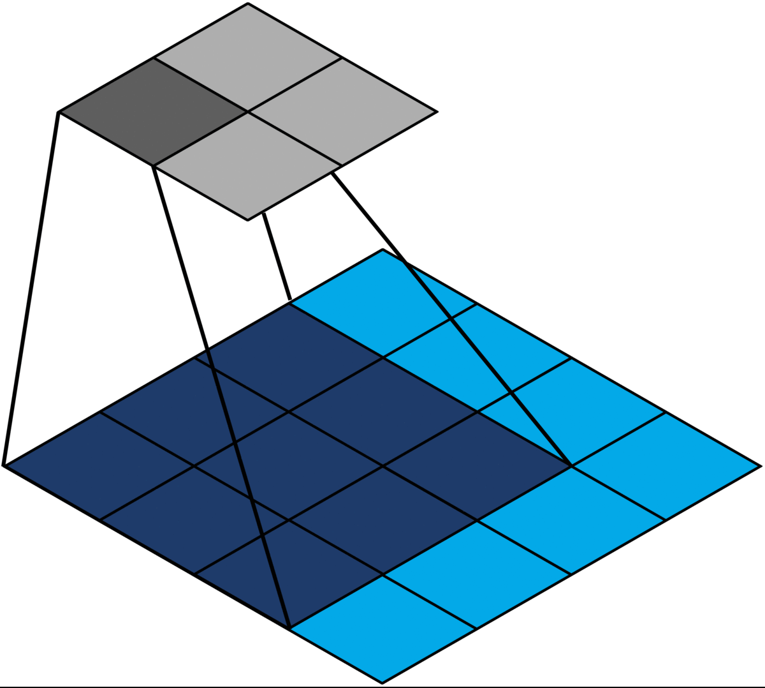
CNN Filters (Animated) (Slide 2 of 2)

Slide 20
CNN Filter Example (Slide 1 of 4)
Input Layer
1
1
1
1
1
Filter
0
0
1
0
0
0
1
0
0
0
1
0
0
0
1
0
0
0
1
0
0
0
1
0
0
0
1
0
0

Slide 21
CNN Filter Example (Slide 2 of 4)
Match
0
1
0
Convolutional Layer with Neuron Firing
1
1
1
1
1
0
1
0
0
0
1
0
0
0
1
0
0
0
1
0
0
0
0
1
0
0
0
0
1
0
0

Slide 22
CNN Filter Example (Slide 3 of 4)
0
1
0
Convolutional Layer with Neuron Firing
1
1
1
1
1
0
1
0
0
0
1
0
0
0
1
0
0
0
1
0
0
0
0
1
0
0
0
0
1
0
0

Slide 23
CNN Filter Example (Slide 4 of 4)
1
3
1
0
3
0
0
3
0

Slide 24
Padding
0
1
0
Zero padding
0
1
0
1
1
1
1
1
0
1
0
0
0
0
0
1
0
0
1
0
0
0
0
1
0
0
0
0
1
0
0

Slide 25
Stride
0
1
0
0
1
0
1
1
1
1
1
0
1
0
0
1
0
0
0
1
0
0
1
0
1
0
0
0
1
0
0
1
1
1
1
0
1
0
0
0
0
1
0
0
0
0
1
0
0
0
1
0
0
0
0
1
0
0
0
0
1
0
0
Stride = 2
0
0
1
0
0

Slide 26
Pooling Layer
Previous Feature Map
1
3
1
1
3
1
0
3
0
0
3
0
New Feature Map
0
3
0
0
3
0
3
3
3
3
1
3
1
1
3
1
0
3
0
0
3
0
0
3
0
0
3
0

Slide 27
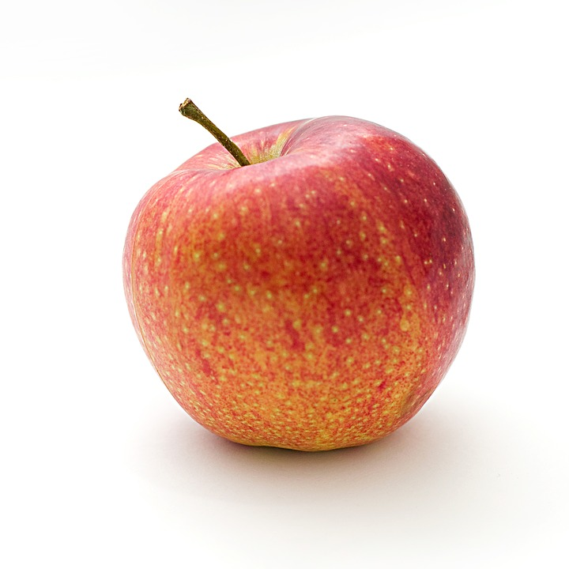


CNN Architecture
Input
Convolution
Pooling
Convolution
Pooling
Fully Connected
Output

Slide 28
Generative Adversarial Network (GAN)
Generative Adversarial Network: A neural network architecture that pits two different neural networks against each other.
One network is discriminative, the other is generative.
Training networks in opposition leads to more skillful models.
Discriminator:
Similar to networks mentioned already.
Predicts a label given a set of features.
Example: Looks for correlations between features to predict heart disease.
Generator:
Does the opposite.
Predicts features given a label.
Maps distribution of feature values and generates new values that fit in distribution.
Example: For a patient with heart disease, determines what features play a role.
Both are in a constant state of conflict.
Generator creates new data to send to discriminator.
Generator wants to "fool" the discriminator, and discriminator wants to detect this.
Tug-of-war strengthens network's ability to generate convincing data.

Slide 29
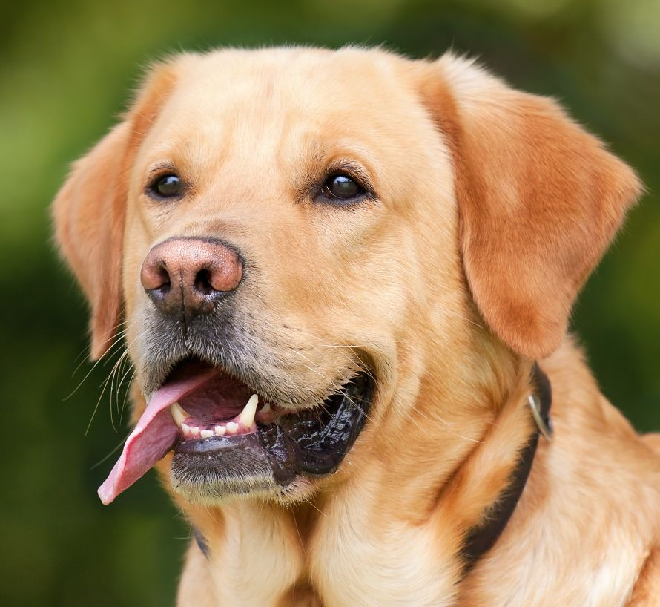
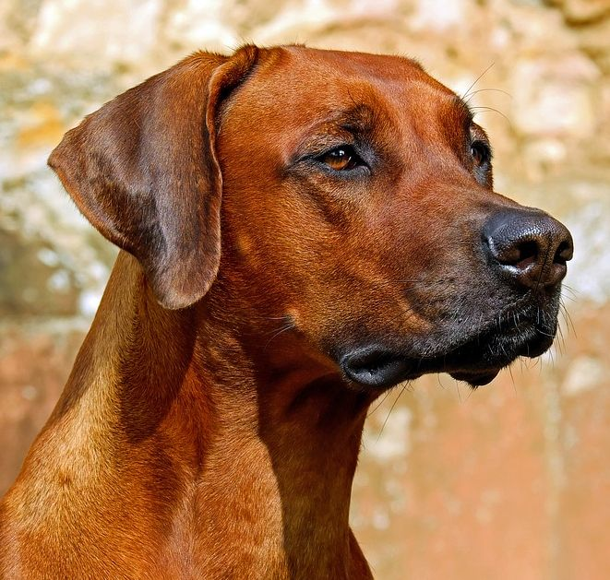
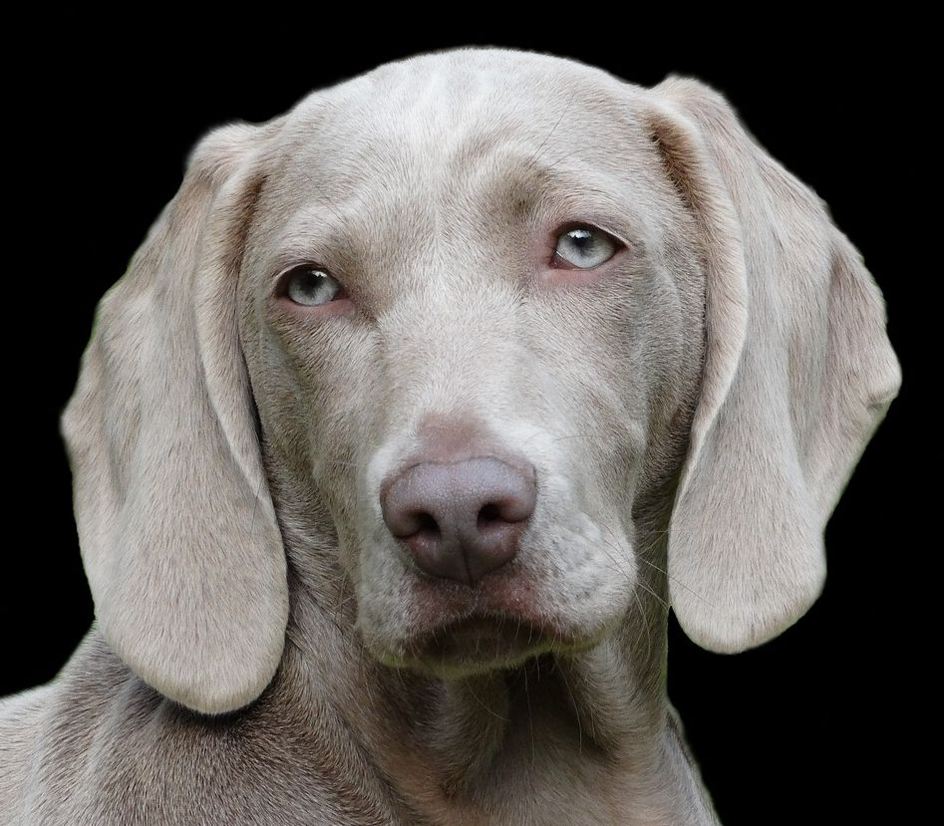
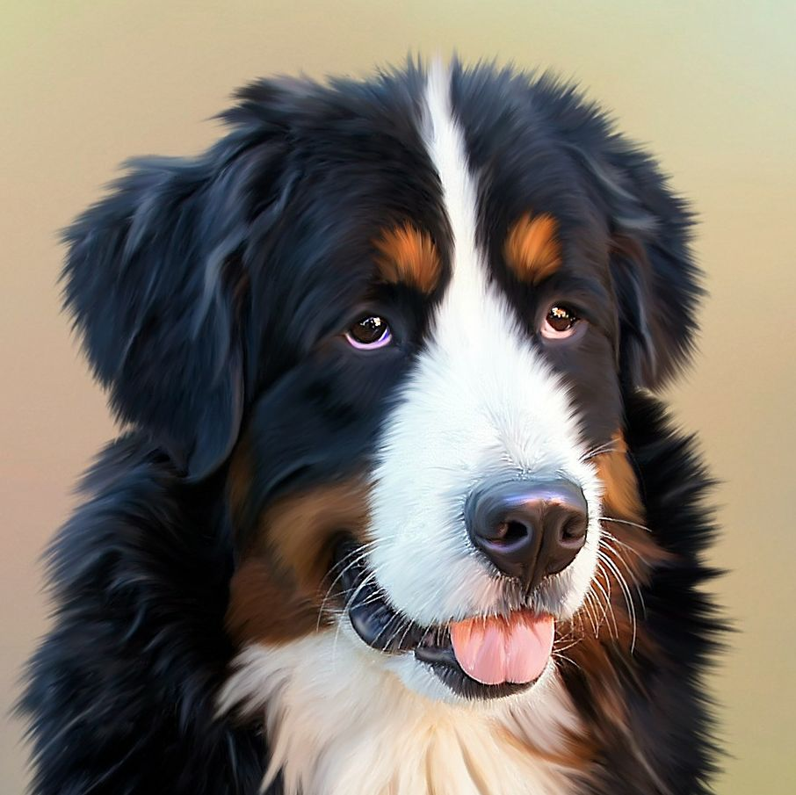

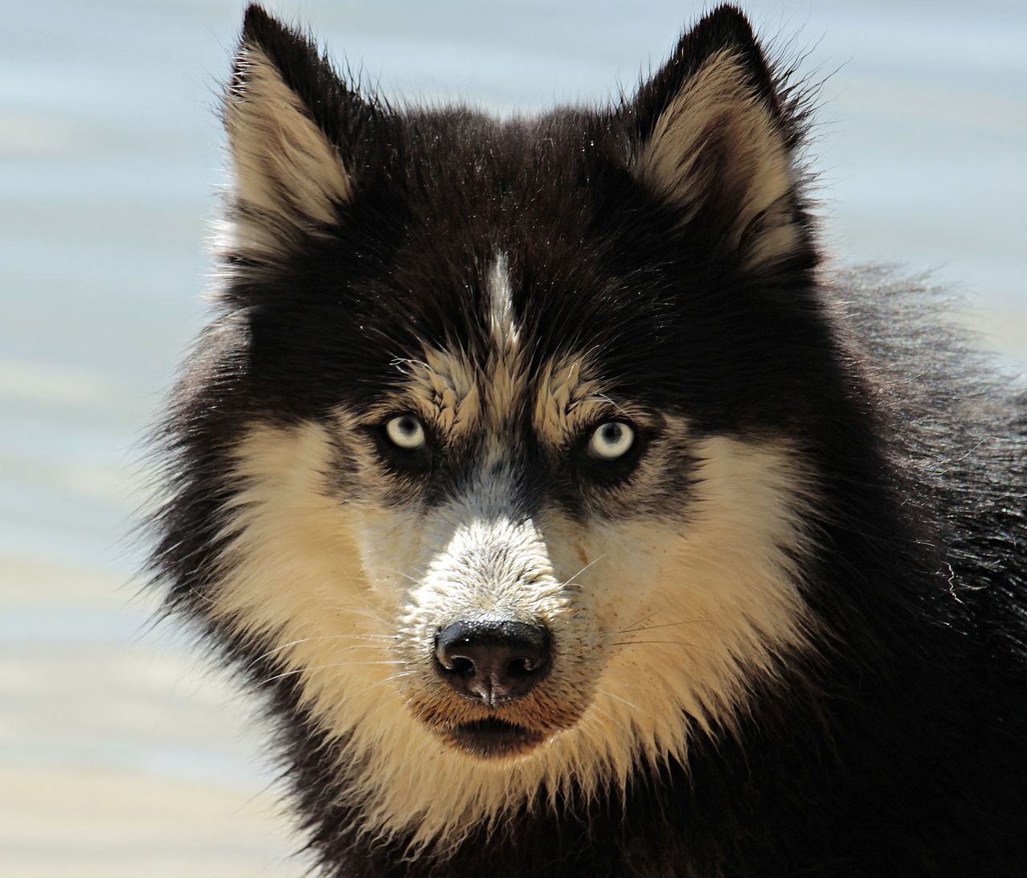
GAN Architecture
Training Set (Real Images)
Discriminator
Real
Forgery
Random Noise
Generator
Forged Image

Slide 30
Build a CNN
Use CNNs for computer vision tasks like image classification.
Use convolutional layers to scan image inputs using filters.
Use padding to enable filters to scan an entire input image.
Use stride to downsample an image, saving on training time.
Use pooling layers to sample portions of input, saving time and reducing overfitting.
Construct CNN with alternative convolutional/pooling layers, ending with fully connected output layer.
Use GANs to generate artificial images or upscale existing images.
Consider the very high computational cost of GAN training.

Slide 31
Use Python for CNNs
Use Keras' Sequential() class and layers module to build a CNN:
network = keras.models.Sequential()
network.add(keras.layers.Conv2D(filters = 64, kernel_size = (2, 2), input_shape = (50, 50, 1), padding = 'same', activation = 'relu'))
network.add(keras.layers.MaxPooling2D((2, 2)))
network.add(keras.layers.Flatten())
network.add(keras.layers.Dense(3, activation = 'softmax'))
network.compile(optimizer = 'sgd', loss = 'categorical_crossentropy', metrics = ['accuracy'])
network.fit(X_train, y_train, validation_data = (X_val, y_val), epochs = 10)
network.summary()
keras.utils.plot_model(network, to_file = 'network.png')
network.evaluate(X_test, y_test)
network.predict(X_test)

Slide 32

Activity: Building a CNN
You work for an online clothing retailer.
You use a custom scheme for categorizing clothing.
Products are categorized manually.
Is this a shoe, a hat, a jacket, etc.?
You want to automate this tedious work.
You have a large database of product images that have been categorized.
You'll train that dataset on a CNN to help classify new clothing images.

Slide 33

Activity: (Optional) Building a CNN to Classify Handwritten Characters
An ancestry search company wants to take scanned historical documents and make their content searchable in a database.
Most of the documents are handwritten.
You'll create a CNN to process the MNIST database of handwritten characters.
Will act as a proof of concept.

Slide 34
Build Recurrent Neural Networks (RNN)

Slide 35
Recurrent Neural Network (RNN) (Slide 1 of 3)
$$Σ$$
Input ($x$)
Output ($y$)

Slide 36
Recurrent Neural Network (RNN) (Slide 2 of 3)
$$Σ$$
$$x$$
$$Σ$$
$$y$$
$$Σ$$

Slide 37
Recurrent Neural Network (RNN) (Slide 3 of 3)
$$y_{0}$$
$$y_{1}$$
$$y_{2}$$
$$x_{0}$$
$$x_{1}$$
$$x_{2}$$
Time

Slide 38
Memory Cell
$$y_{t}$$
$$h_{t−1}$$
$$h_{t}$$
tanh
$$x_{t}$$

Slide 39
RNN Training
Backpropagation through time (BPTT): The process of training an RNN.
Time sequence of RNN layers is unrolled.
Backpropagation is performed just as it is for a traditional ANN.
Error gradients are identified starting at last time step.
Gradients are propagated backward for next layer's error calculation.
Repeats until reaching first time step.
Weights between neurons are updated.

Slide 40
RNN Shortcomings
RNNs can suffer performance issues on long input sequences.
Can reduce time steps used for unrolling to reduce computational needs.
Model may not learn patterns that manifest over a long time.
Can lead to reduction in model skill.
Memory cell issue:
Some data, through calculations, is lost in the network.
Later memory cells start missing key pieces of info.
Example: Review might start, "I really like this place, but …"
Review is positive, but network might "forget" this initial sentence.
More complex and effective memory cell is required.

Slide 41
Long Short-Term Memory (LSTM) Cell
Long Short-Term Memory (LSTM) Cell: A memory cell in which the hidden state comprises two vectors: a short-term state and a long-term state.
Able to preserve input significant to training process.
Able to "forget" input that is not significant.
Speeds up training.
Used in NLP.
Suitable with sequential processing of input, like text.
Also useful in forecasting time series.
Can predict trends based on past information, like expected sales over time.

Slide 42
LSTM Cell Architecture
$$y_{t}$$
$$c_{t−1}$$
X
+
$$c_{t}$$
X
tanh
X
$$h_{t}$$
$$f_{t}$$
$$g_{t}$$
$$i_{t}$$
$$o_{t}$$
$$σ$$
tanh
$$σ$$
$$σ$$
$$h_{t−1}$$
$$x_{t}$$

Slide 43
LSTM Cell Process (Slide 1 of 2)
Previous cell's long-term state (c_{t − 1}) is pointwise multiplied by result of forget gate (f_{t}).
Result of input gate (i_{t}) is pointwise multiplied by result of tanh function layer (g_{t}).
Result from step 1 is pointwise added to result from step 2.
Produces next cell's long-term state (c_{t}).
Result from step 3 is run through tanh function, then this is pointwise multiplied by result of output gate (o_{t}).
Produces next cell's short-term state (h_{t}).
May also be sent as output y_{t}.

Slide 44
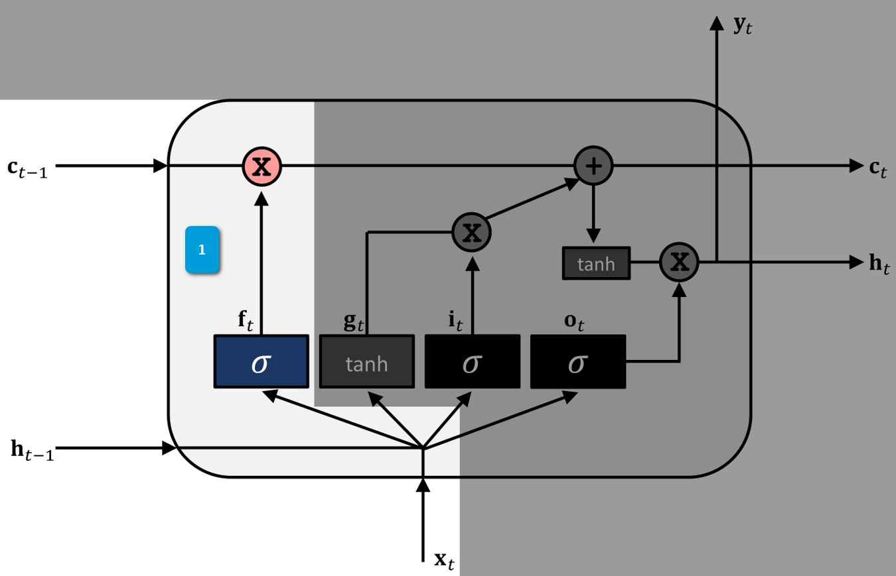
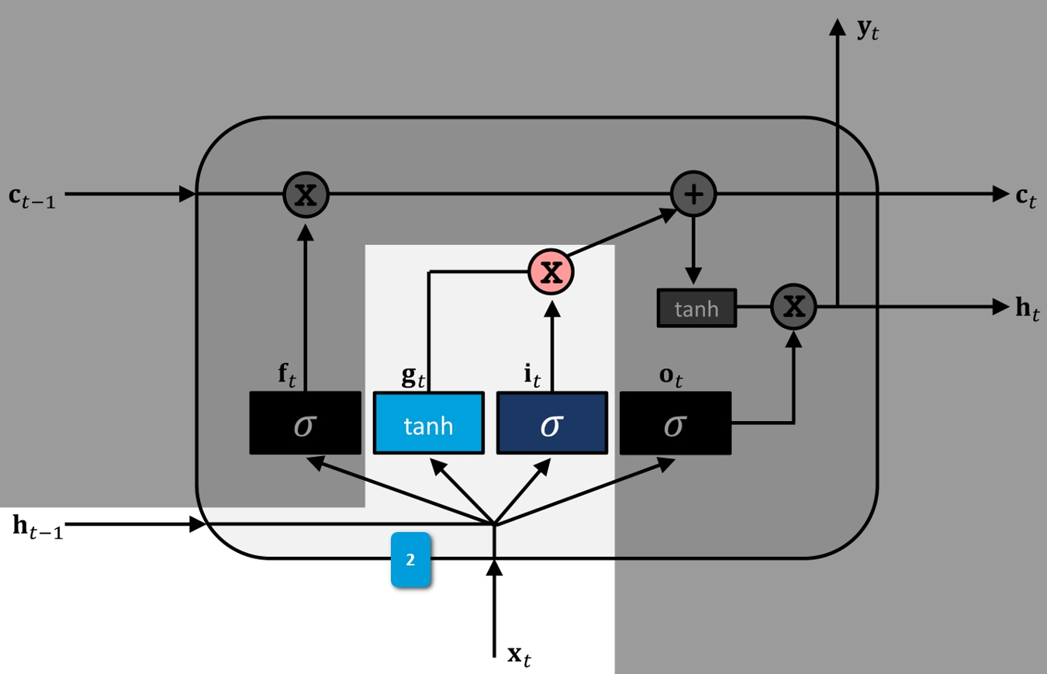
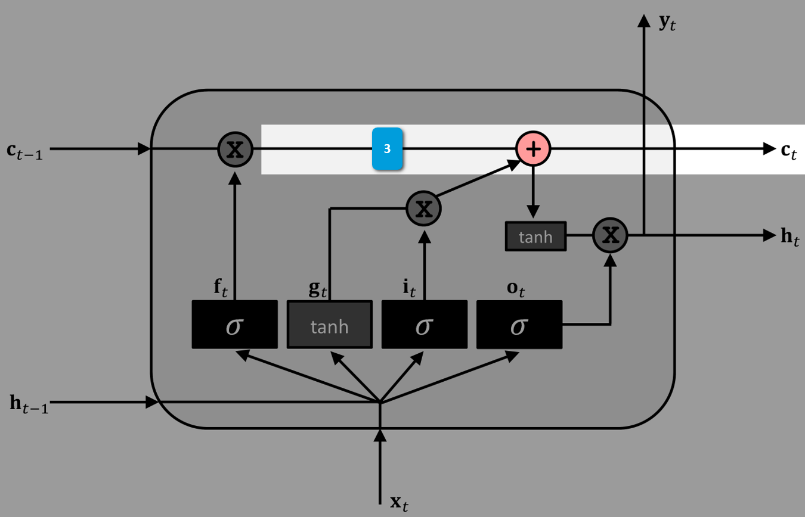
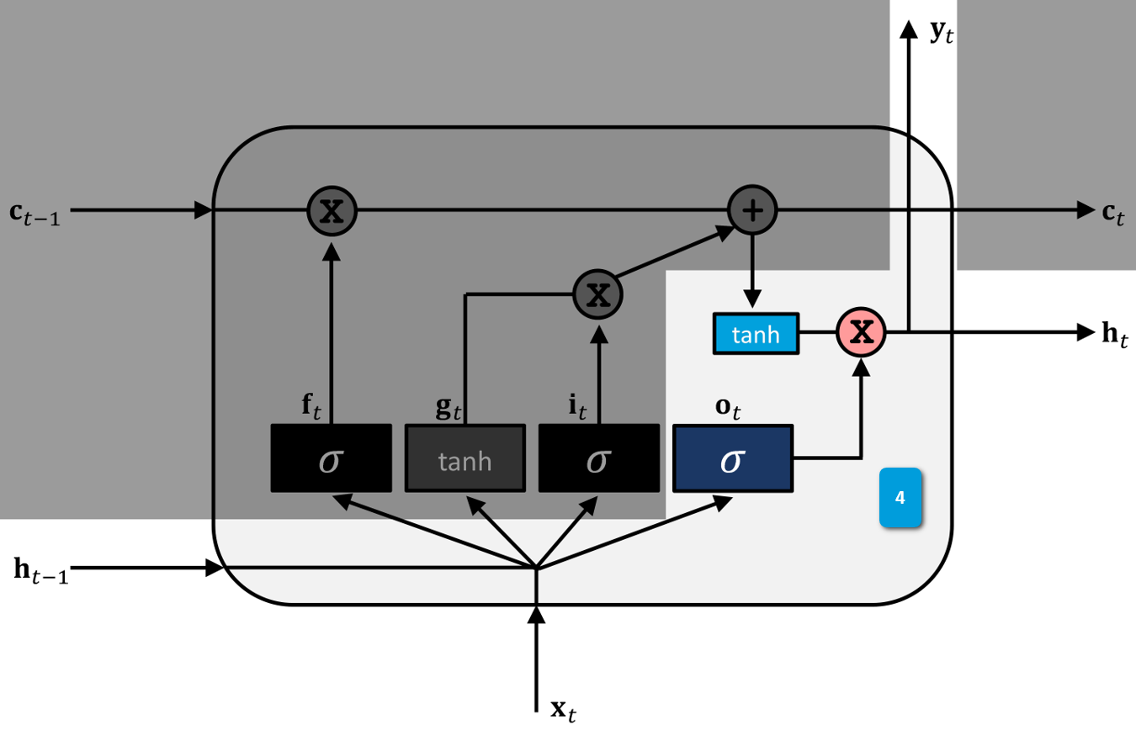
LSTM Cell Process (Animated) (Slide 2 of 2)

Slide 45
Embedding
Embedding: The process of condensing a language vocabulary into small-dimensional vectors.
These vectors are more efficient than traditional encoding schemes.
Example: One-hot encoding a word into 40,000 possible words.
Would have 39,999 values of 0—very inefficient.
Embedding represents a word as its own vector.
Usually no more than a few hundred dimensions.
Vectors constitute overall embedded space.
Vector occupies a point in this space.
Network trains vectors on some language input to find similarities between words.
Similar words placed close together in embedded space.
Network can group together words in meaningful ways.
Consider leveraging pre-trained embeddings.
If training your own embeddings, consider the following tools:
Word2vec
Doc2vec
fastText

Slide 46
Bag-of-Words
Bag-of-Words: A list of each individual word in a text without respect to grammar, punctuation, etc.
Used as a way to represent text for training, before being embedded as vectors.
Example: "I really enjoyed this movie—more than I enjoyed the first one."
List: ['I', 'really', 'enjoyed', 'this', 'movie', 'more', 'than', 'I', 'enjoyed', 'the', 'first', 'one']
Dictionary: {'I': 2, 'really': 1, 'enjoyed': 2, 'this': 1, 'movie': 1, 'more': 1, 'than': 1, 'the': 1, 'first': 1, 'one': 1}
Similar approach: bag-of-n-grams.
Each element is an n-gram rather than a word.
Commonly used to represent features for language classification.

Slide 47
Build an RNN
Use RNNs for NLP tasks like text classification.
Use RNNs for predicting time sequence data.
Use LSTMs over standard memory cells to reduce training time and improve model skill.
Consider using GRU cells for potentially even more training time improvement.
Use word embeddings to condense language vocabulary into small vectors.
Consider using pre-trained word embeddings to cut down on training time.
Use tools like Word2vec or fastText if you want to train your own embeddings.

Slide 48
Use Python for RNNs
Use Keras' Sequential() class and layers module to build an RNN:
network = keras.models.Sequential()
network.add(keras.layers.Embedding(input_dim = 5000, output_dim = 200, input_length = 1000))
network.add(keras.layers.LSTM(units = 128))
Use the same Flatten() and Dense() layers.
Use same object methods as with a Keras CNN.

Slide 49

Activity: Building an RNN
Users can leave reviews of products on storefront.
Business can learn a lot about what customers think from these reviews.
Until now, human personnel have read reviews to determine their sentiment.
You'll automate the process through RNN-based NLP.
The model will classify reviews as either positive or negative.

Slide 50
In your own environment, how might you use convolutional neural networks (CNNs) to solve business problems?
In your own environment, how might you use recurrent neural networks (RNNs) to solve business problems?

